Slide 1




Appian AI Challenge
Project-1
Classification and processing of unstructured financial documents
Access links
Pradipta Sundar Sahoo
Indian Institute of Technology (IIT) Roorkee
pradipta_ss@ch.iitr.ac.in

Slide 2
Agenda
About the project
Features
Proposed Solution
Results
Access links
Tip: Use links to go to a different page inside your presentation.
How: Highlight text, click on the link symbol on the toolbar, and select the page in your presentation you want to connect.
Future Advancements
Setup Instructions
Usage
DB Architecture

Slide 3

About
Goal: To automate the classification, association, and summarization of unstructured financial documents, enabling faster processing and reducing manual effort while maintaining accuracy and scalability.
Key Objectives:
Document Categorization
Summarization
Scalability and Efficiency, Ease of Use, Accuracy and Reliability
BACK TO AGENDA PAGE

Slide 4



Key Features
Caching
OCR Integrated Tool
Hierarchical Classification
Speeds up access to processed data using Redis for frequently accessed information.
Extracts text efficiently from PDFs and images using robust OCR tools.
Organizes documents by individual, type, and subcategories
Vector Search
Database Management
Handles large volumes of FAQs and multiple user queries.
Stores structured data securely with SQLite for auditability and redundancy.
BACK TO AGENDA PAGE

Slide 5

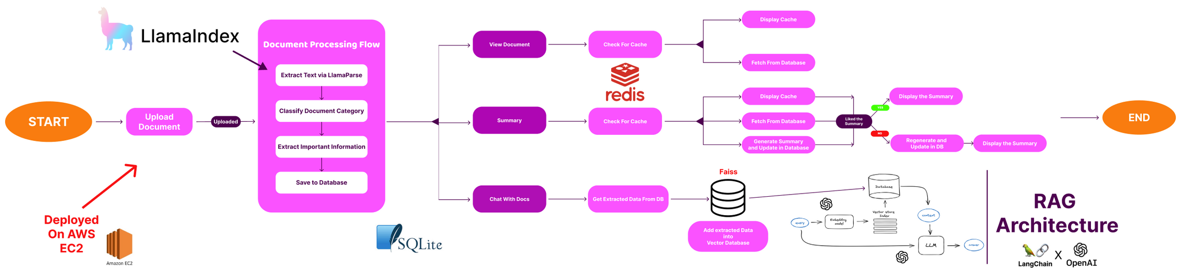
Prosposed Solution
BACK TO AGENDA PAGE

Slide 6








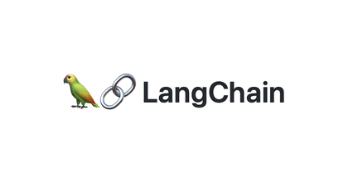
Techniques used
Recursive Text Splitting: Uses RecursiveCharacterTextSplitter for breaking down documents into manageable chunks while maintaining context
Retrieval Augmented Generation (RAG): Implements a hybrid approach combining document retrieval with LLM generation for accurate document-based chat
Vector Similarity Search: Employs FAISS for efficient document similarity matching and retrieval
Caching Strategy: Uses a multi-level caching system combining Redis for distributed caching and local LRU cache for frequently accessed data
State Management: Implements custom state handling for chat sessions and document processing workflows.
Technology used
LlamaParse: For robust PDF and document text extraction
OpenAI GPT-4: Powers the document classification, summarization, and chat functionality
Streamlit: Frontend framework for the web interface
Redis: Distributed caching system for document data and chat history
SQLite: Local database for document storage and metadata
FAISS: Vector database for efficient similarity search
LangChain: Framework for building the RAG pipeline
LangGraph: For managing conversational workflows and state
BACK TO AGENDA PAGE

Slide 7

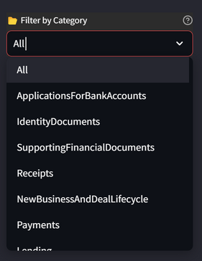
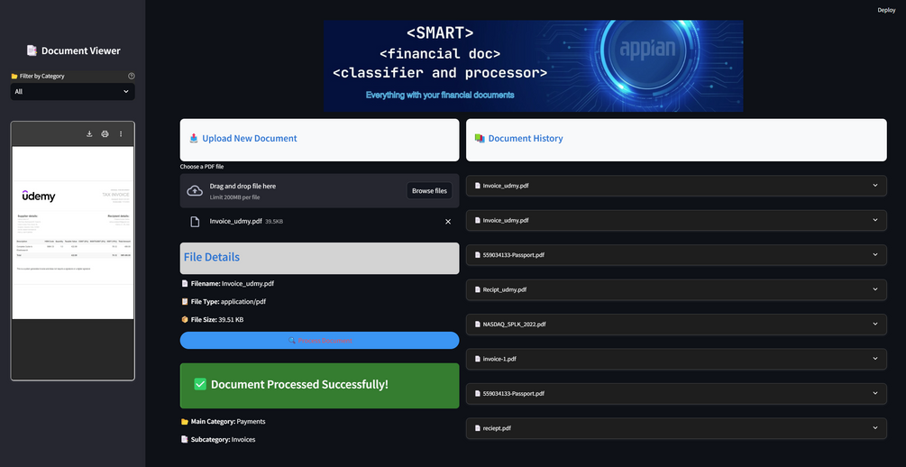
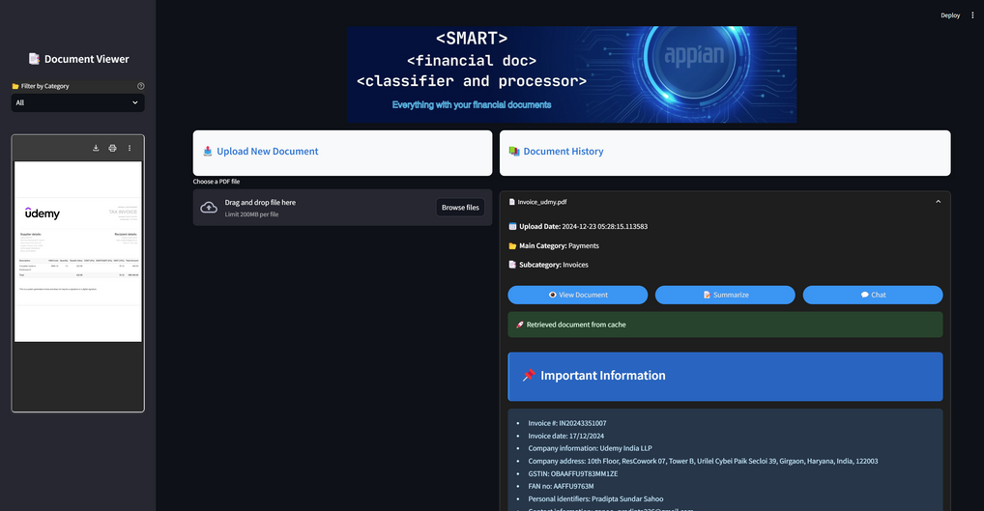
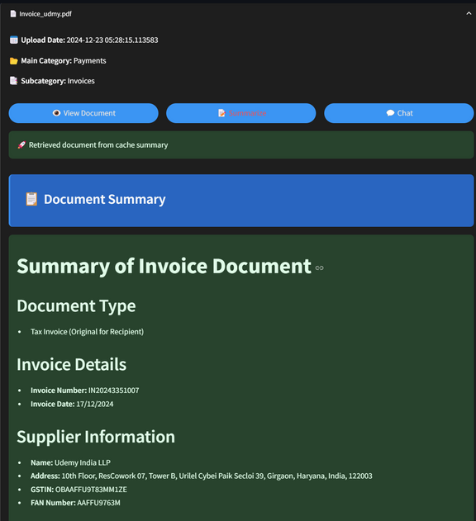
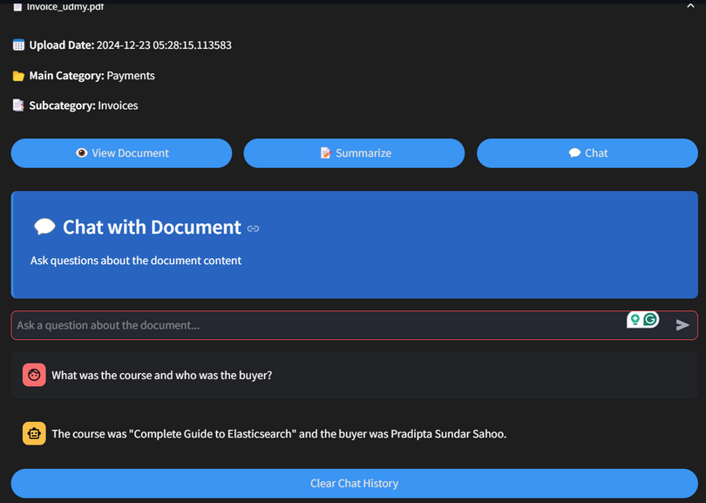
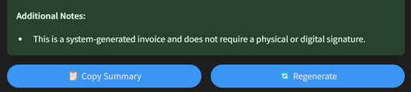
Tap to view the document and important info
1. Upload Document
2. View Document
You can select the category of documents you have uploaded earlier
3. Summarise
4. Chat With the Doc
Output :
Results
You can regenerate the summary

Slide 8
Bonus Video:
Bonus Video Link
Live Access Link:
I was working on a finance project myself,which is not published yet anywhere(till now).
Have A Look!!!
120 page Bank statement,with lots of numbers
Appian AI Fin Document
Demo Video Link:
Demo Video Link
Access Links
Github Link:
Github Repo Link
BACK TO AGENDA PAGE

Slide 9
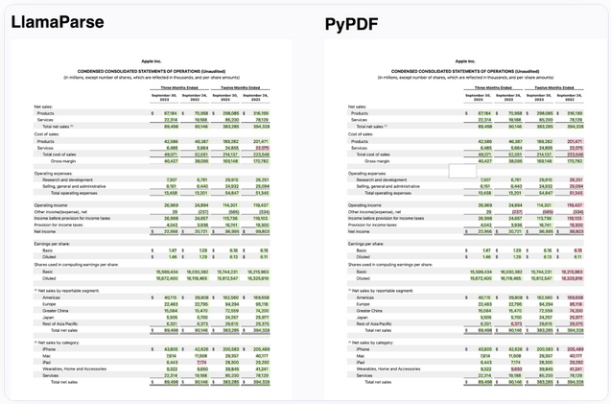

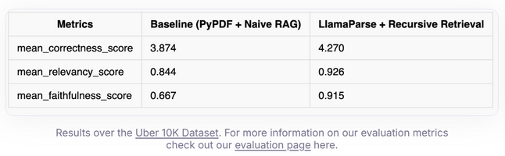
Evaluation?
The most important thing.
Have updated evaluation.py
But need to create a test dataset manually.
Which I will do on moving to next round.
LlamaParse Wins !!!
GPT-4o , undoubtedly one of the best
Notes:
Faithfulness:highly aligned with retrieved documents.
Answer Relevancy:
Context Precision: Limits irrelevant content
Context Recall: necessary context for accurate answers.
Context Entity Recall:Retains most critical entities for complete responses.
Answer Similarity: generated answers == with expected responses.
Answer Correctness: Boosts factual accuracy to minimize errors.
Harmfulness: Maintains zero tolerance for harmful content.

Slide 10

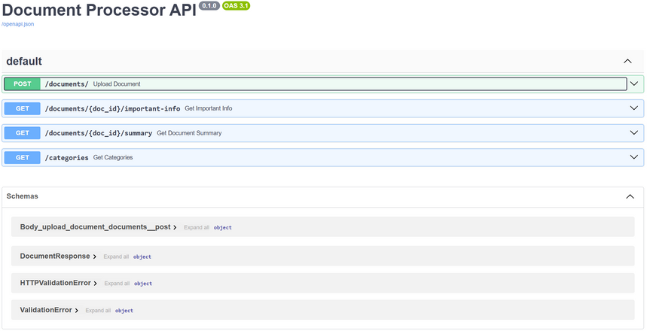
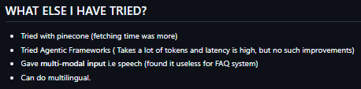
Future
Advancements
Multimodal input and output:
have already been implemented.(in repo). But do we actually need it?
Multilingual:
knows how to implement. Could be useful !!!.
Faster Inference :
could use small llms.
Scalability:
have already implemented a FastAPI code. It could be used for production. (in repo).
Relevance:
Reranked all results according to relevance. May a more robust way be done.
More robust:
I have already some extra info about different categories that APPIAN could track in future.
But more info can be fed.
Cost-effective:
Instead of EC2, can be deployed in serverless instances.
More intermediate stuffs can be removed to lower the tokens count.
API
Serverless
Loading Model
EC2

Slide 11
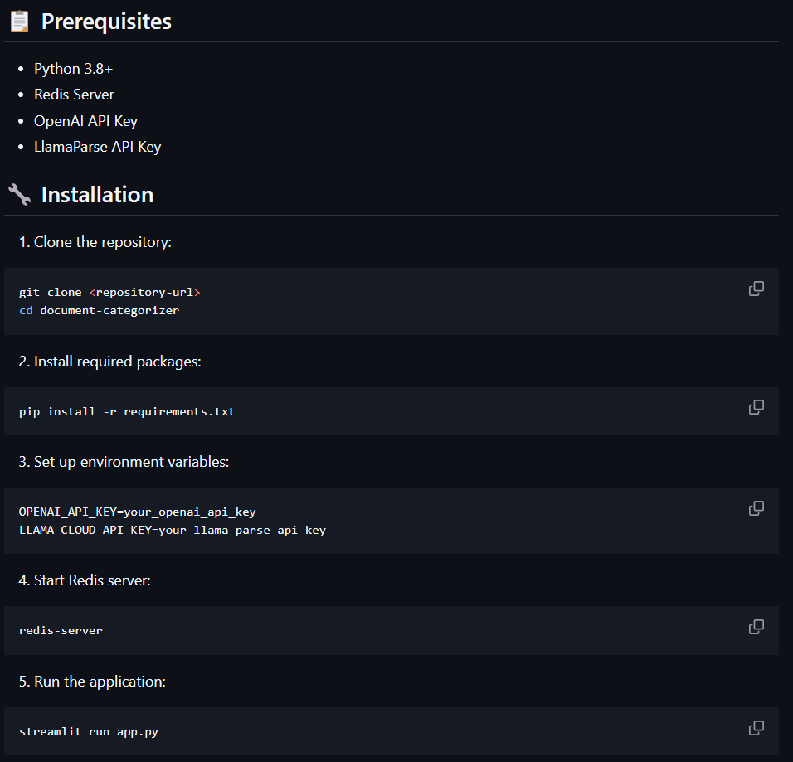
Setup
Instructions
Github Repo Link
BACK TO AGENDA PAGE

Slide 12
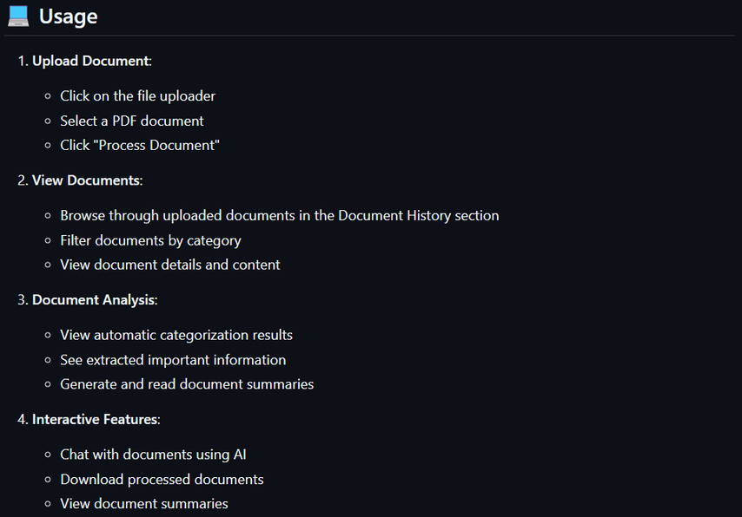
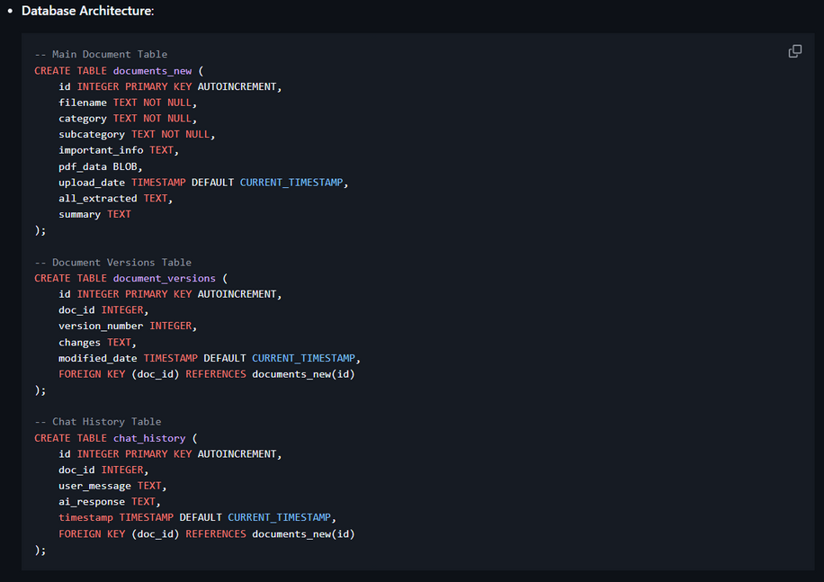
Usage
Github Repo Link
DB Architecture
Github Repo Link
BACK TO AGENDA PAGE

Slide 13
BACK TO AGENDA PAGE
Thank You

Slide 14
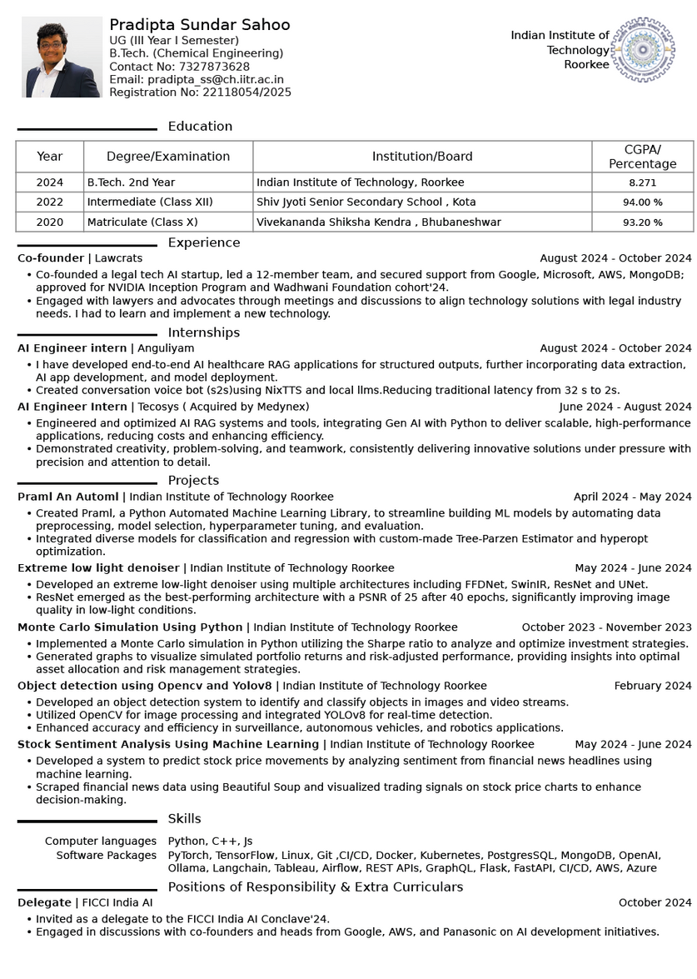
About Me
Avid Learner with strong problem solving skills.
Keep tracks of recent GenAI Hacks
Worked with multiple startups (healthtech,legaltech,fintech) build their MVP.
Collaborated with cross-domain teams, showcasing good leadership and team management skills.
Currently, focussing on AI Agents Architecture.

